Slide 1
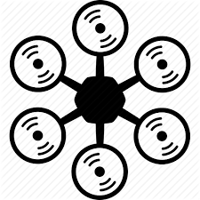
Thrust vector – max 1024gm for each motor
Payload vector – 6kg capacity(As centered as possible)
The overall weight of the drone with all its parts attached to it excluding the payload is : 1,434gm
Which gives the maximum thrust capacity left : 4,566gm
By applying environmental filter for NTP and wind : 4,300gm
Finally applying flying filter of (6.018:1) according to NTP and clear weather assumption : 2,300gm.
Hence for comfortable flying, the capacity of the drone is 2,300gm carry weight.

